Slide 1

Gold_finance_ETL: Automating Financial Data Pipelines
Welcome to our presentation on Gold_finance_ETL, a robust data engineering project that automates financial time series data processing. We'll explore how this pipeline transforms raw financial data into structured insights for business stakeholders and analysts.
Alpha Team
IN

Slide 2

Overview: What is Gold_finance_ETL?
Automated ETL Pipeline
Advanced Technologies
Extracts, transforms, and loads financial data from Alpha Vantage API daily.
Utilizes PySpark, PostgreSQL, and Apache Airflow for efficient data processing.

Slide 3
Business Problem and Solution
Challenges
Gold_finance_ETL Solution
High volume of rapidly changing financial data
Fully automated workflows for daily data integration and analysis
Unstructured formats requiring significant cleaning
Time-intensive manual workflows prone to errors
Aggregated metrics for informed decision-making
Alpha

Slide 4




Data Source: Alpha Vantage API
Comprehensive Data
Provides daily prices and trading volumes for multiple financial symbols.
Daily Updates
Ensures accurate and timely data for trend analysis.
Industry Standard
Widely used and trusted in the financial industry.

Slide 5





Technologies Used
Apache Airflow
1
Orchestration and scheduling
PySpark
2
Data transformation at scale
PostgreSQL
3
Data storage and aggregation
Python & SQL
4
Core scripting and querying
WSL Docker (Optional)
5
Containerized deployments
Alpha

Slide 6
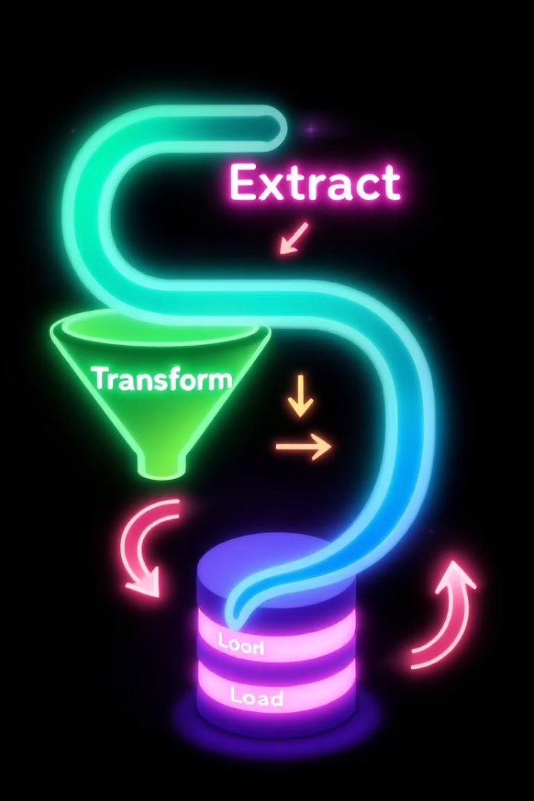




Pipeline Workflow
Extraction
Fetch data from Alpha Vantage API using extract.py module.
Transformation
Process raw JSON data into structured DataFrames using PySpark.
Loading
Insert data into PostgreSQL using incremental loading.
Aggregation
Generate insights using SQL procedures.

Slide 7

Key Features and Benefits
Incremental Loading
Automated Orchestration
Optimizes resource usage by processing only new data daily.
Airflow DAG ensures seamless daily runs and failure recovery.
Scalable Design
Actionable Insights
Ready for future expansion and additional data sources.
Provides ready-to-use KPIs for data-driven decision-making.
Alpha

Slide 8

Future Enhancements
1
Dashboard Integration
Connect PostgreSQL to BI tools like Tableau or Power BI.
2
Real-Time Processing
Incorporate Kafka for streaming data ingestion.
3
Additional Data Sources
Expand to other APIs for broader analysis.
4
Machine Learning
Predict trends using historical data.
Alpha

